Slide 1

Inheritance
Lecture: Inheritance

Slide 2
Inheritance
Inheritance can be defined as the process where one object acquires the properties of another.
With the use of inheritance the information is made manageable in a hierarchical order.

Slide 3
Inheritance
When we talk about inheritance, the most commonly used keyword would be extends and implements.
These words would determine whether one object IS-A type of another. By using these keywords we can make one object acquire the properties of another object.

Slide 4
Inheritance
public class Animal{ }
public class Mammal extends Animal{ }
public class Reptile extends Animal{ }
public class Dog extends Mammal{ }

Slide 5
Inheritance
Now, based on the above example, In Object Oriented terms, the following are true:
Animal is the superclass of Mammal class.
Animal is the superclass of Reptile class.
Mammal and Reptile are subclasses of Animal class.
Dog is the subclass of both Mammal and Animal classes.

Slide 6
Inheritance
Now, if we consider the IS-A relationship, we can say:
Mammal IS-A Animal
Reptile IS-A Animal
Dog IS-A Mammal
Hence : Dog IS-A Animal as well

Slide 7
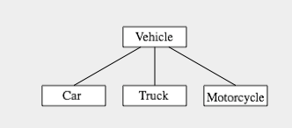
Inheritance example

Slide 8
Inheritance
class Vehicle {
int registrationNumber;
Person owner; // (Assuming that a Person class has been defined!)
void transferOwnership(Person newOwner) {
. . .
}
. . .
}
class Car extends Vehicle {
int numberOfDoors;
. . .
}
class Truck extends Vehicle {
int numberOfAxles;
. . .
}
class Motorcycle extends Vehicle {
boolean hasSidecar;
. . .
}

